Slide 1


MEMBERS:
ARISH - 2112140
MUBEEN -2112151
TRIVIATRACK
CHALLENGE YOUR MIND, MASTER THE GAME.
SUPERVISOR:
DR. ADEEL ANSARI

Slide 2
TABLE OF CONTENTS
01.
Introduction
02.
Problem Statement
03.
Target Industry
04.
Problem Solution
05.
Scope
06.
Tools & Tech
07.
FYP I Features
08.
FYP II Features
08.
Milestones FYP

Slide 3



TRIVIATRACK
Introduction
Overview
TriviaTrack is a gamified learning platform that makes education engaging by using interactive elements and games. Users earn a virtual currency, TriviaCoin, to unlock more courses.
The aim is to enhance knowledge retention through a fun, interactive platform that motivates learners with rewards like TriviaCoin for unlocking advanced content.
Objective

Slide 4

TRIVIATRACK
Problem Statement
What:
Traditional learning methods are often boring and fail to engage students and professionals effectively, leading to poor knowledge retention and lack of motivation.
Why:
There's a need for an educational platform that makes learning enjoyable and rewarding. By gamifying the learning experience and introducing a virtual currency system, users can stay motivated, engaged, and more likely to retain knowledge.

Slide 5

TRIVIATRACK
Target Industry
01. Education
02. Corporate Training / Process
03. Professional Development
04. Information Technology

Slide 6

TRIVIATRACK
Problem Solution
Interactive Learning: Utilizes game-based elements to enhance user engagement.
AI Personalization: Employs AI to customize learning paths based on user performance.
Real-Time Features: Implements live Q&A and peer competitions and grading for interactive learning.

Slide 7

TRIVIATRACK
Scope
Included
Limitations
The virtual currency (TriviaCoin) will not be buyable or sellable outside the platform at this stage.
Development of educational content; initial deployment will use existing materials.
Offline access; the platform assumes users have stable internet connections.
Multilingual support; initial development will focus on a single language interface.
Development of the gamified learning and testing platform with core features.
Implementation of the AI recommendation system.
Creation of the virtual currency system (TriviaCoin) within the platform.
Features like peer competitions, leaderboards, and live Q&A sessions.

Slide 8







TRIVIATRACK
FRONT-END
BACK-END
DATABASE
TAILWIND CSS
NODE JS
MONGO DB
Tools & Technology
REACT JS
EXPRESS JS
ARTIFICAL INTELLIGENCE
GAMIFICATION
COMMUNICATION
TENSOR FLOW
UNITY
SOCKET.IO
BRAIN JS
SANDBOX
PHASER

Slide 9

TRIVIATRACK
FYP I FEATURES
User Interface & CRUD
Course Management
User Management
Developing attractive and engaging user interface for audience and make the functionality usable
This feature will allow teachers and administrator to manage and add gamified courses.
This feature will allow admin, users and teachers to manage permissions, add user, community competitions and collaborations.
Dashboard
Peer Grading & Competitions
Live Q&A Sessions
A Dashboard panel for admins to track the student activities, For teacher and students they can watch their progress and new recommendations according to the learning.
Peer grading allows users to evaluate and provide feedback on each other's work.
Competitions will allow users to compete against each other in real-time making it more engaging.
Live QnA sessions will allow user to ask questions to the teachers using online call and chat functionality.

Slide 10

TRIVIATRACK
FYP II FEATURES
Ranking System
Gamified Courses and Test
Currency (TRIVIA COIN)
Students Highest Record and skills will be shown in categories (Gold, silver, bronze) and will be rewarded with medals based on the performance.
This feature will allow users to play the gamified courses and teachers will evaluate the users through gamified assessments.
Trivia Coins will be rewarded to the beginners in order to purchase and unlock new courses and use hints in their assessments.
Forum/Chat Service
AI Recommendation System
Scoring & Rewarding
This feature will allow user to collaborate and communicate with different users and teachers based on their similar interest (Inspiration: REDDIT).
This feature will allow the lost users to take a gamified quiz to evaluate their current level and help the user to find right courses based on the score
This feature will also evaluate currently enrolled student assessments and will teacher to identify the weak spots of students.
This feature will allow user to unlock achievements and medals to showcase on their profile and to keep track of all their milestone achieved.

Slide 11

TRIVIATRACK
MILESTONE FYP
01.
02.
03.
DEVELOPMENT PHASE (WEEKS 10-16)
PROJECT PLANNING (WEEKS 1-4)
DESIGN PHASE (WEEKS 5-10)
REQUIREMENT ANALYSIS
PROJECT SCOPE DEFINITION
FEASIBILITY STUDY
PROJECT PLAN & SCHEDULE DEVELOPMENT
ADMIN FEATURES DEVELOPMENT
IMPLEMENT USER MANAGEMENT FEATURES
DEVELOP CONTENT MANAGEMENT SYSTEM
TEACHER FEATURES DEVELOPMENT
IMPLEMENT LIVE Q&A SESSION FEATURE
SET UP CERTIFICATION ISSUANCE
CREATE PEER AND COMPETITION GRADING SYSTEM
SYSTEM ARCHITECTURE DESIGN
DATABASE SCHEMA DESIGN
UI/UX DESIGN
04.
DEVELOPMENT PHASE 2 (WEEKS 17-31)
05.
06.
TESTING PHASE
DOCUMENTATION PHASE
RANKING SYSTEM
GAMIFIED TEST & COURSES
CURRENCY (TRIVIA COIN)
PAYMENT GATEWAYS
CHAT AND FORUM
AI RECOMMENDATION SYSTEM
SCORING/REWARD SYSTEM
TEST ADMIN FEATURES
TEST TEACHER FEATURES
TEST STUDENT FEATURES
INTEGRATION TESTING
USER ACCEPTANCE TESTING
TECHNICAL DOCUMENTATION
SDS ( SOFTWARE DESIGN SPECIFICATION)
SRS ( SOFTWARE REQUIREMENT SPECIFICATION

Slide 12
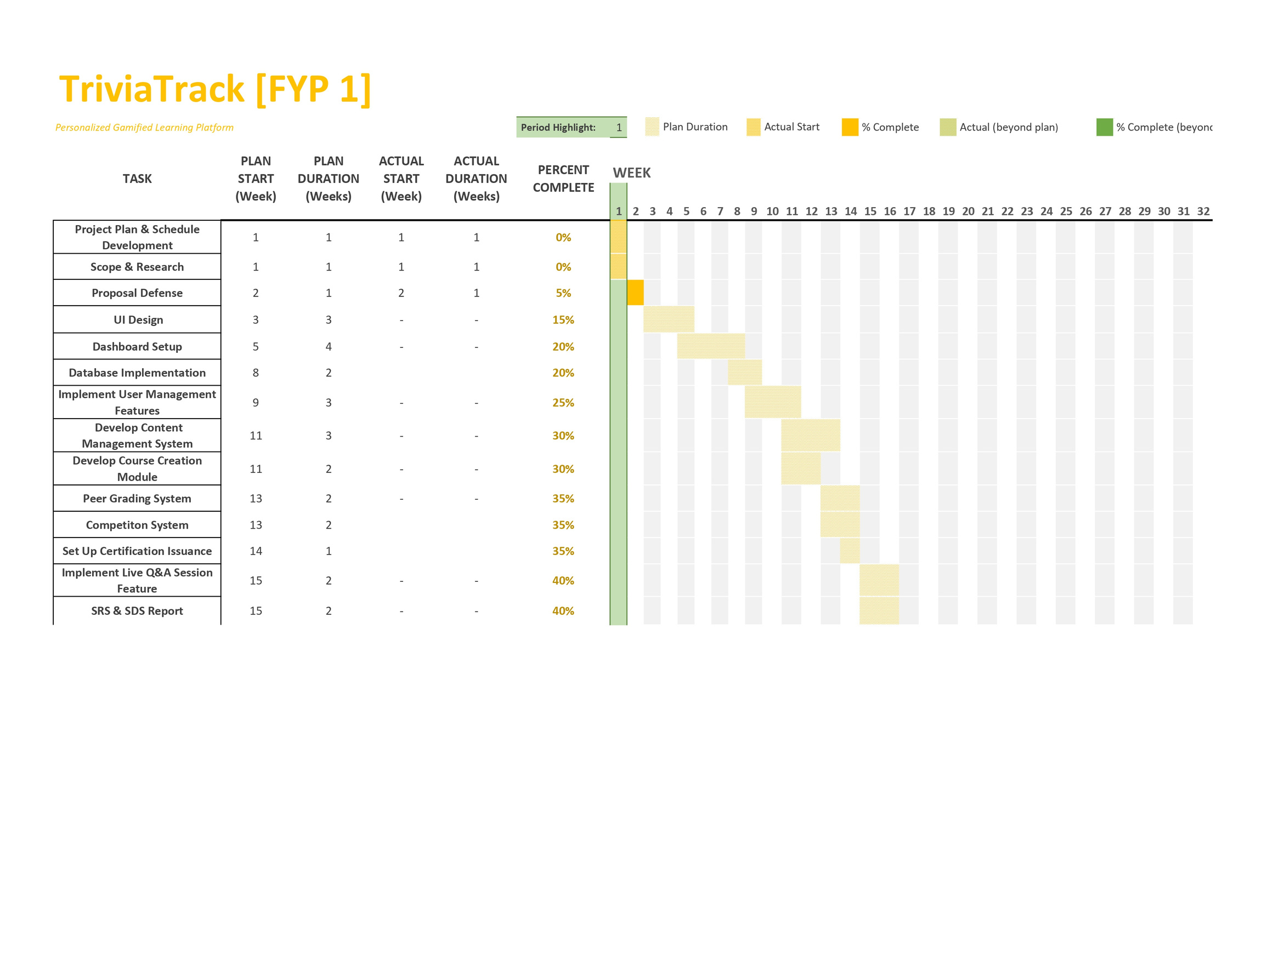
TRIVIATRACK
FYP I

Slide 13
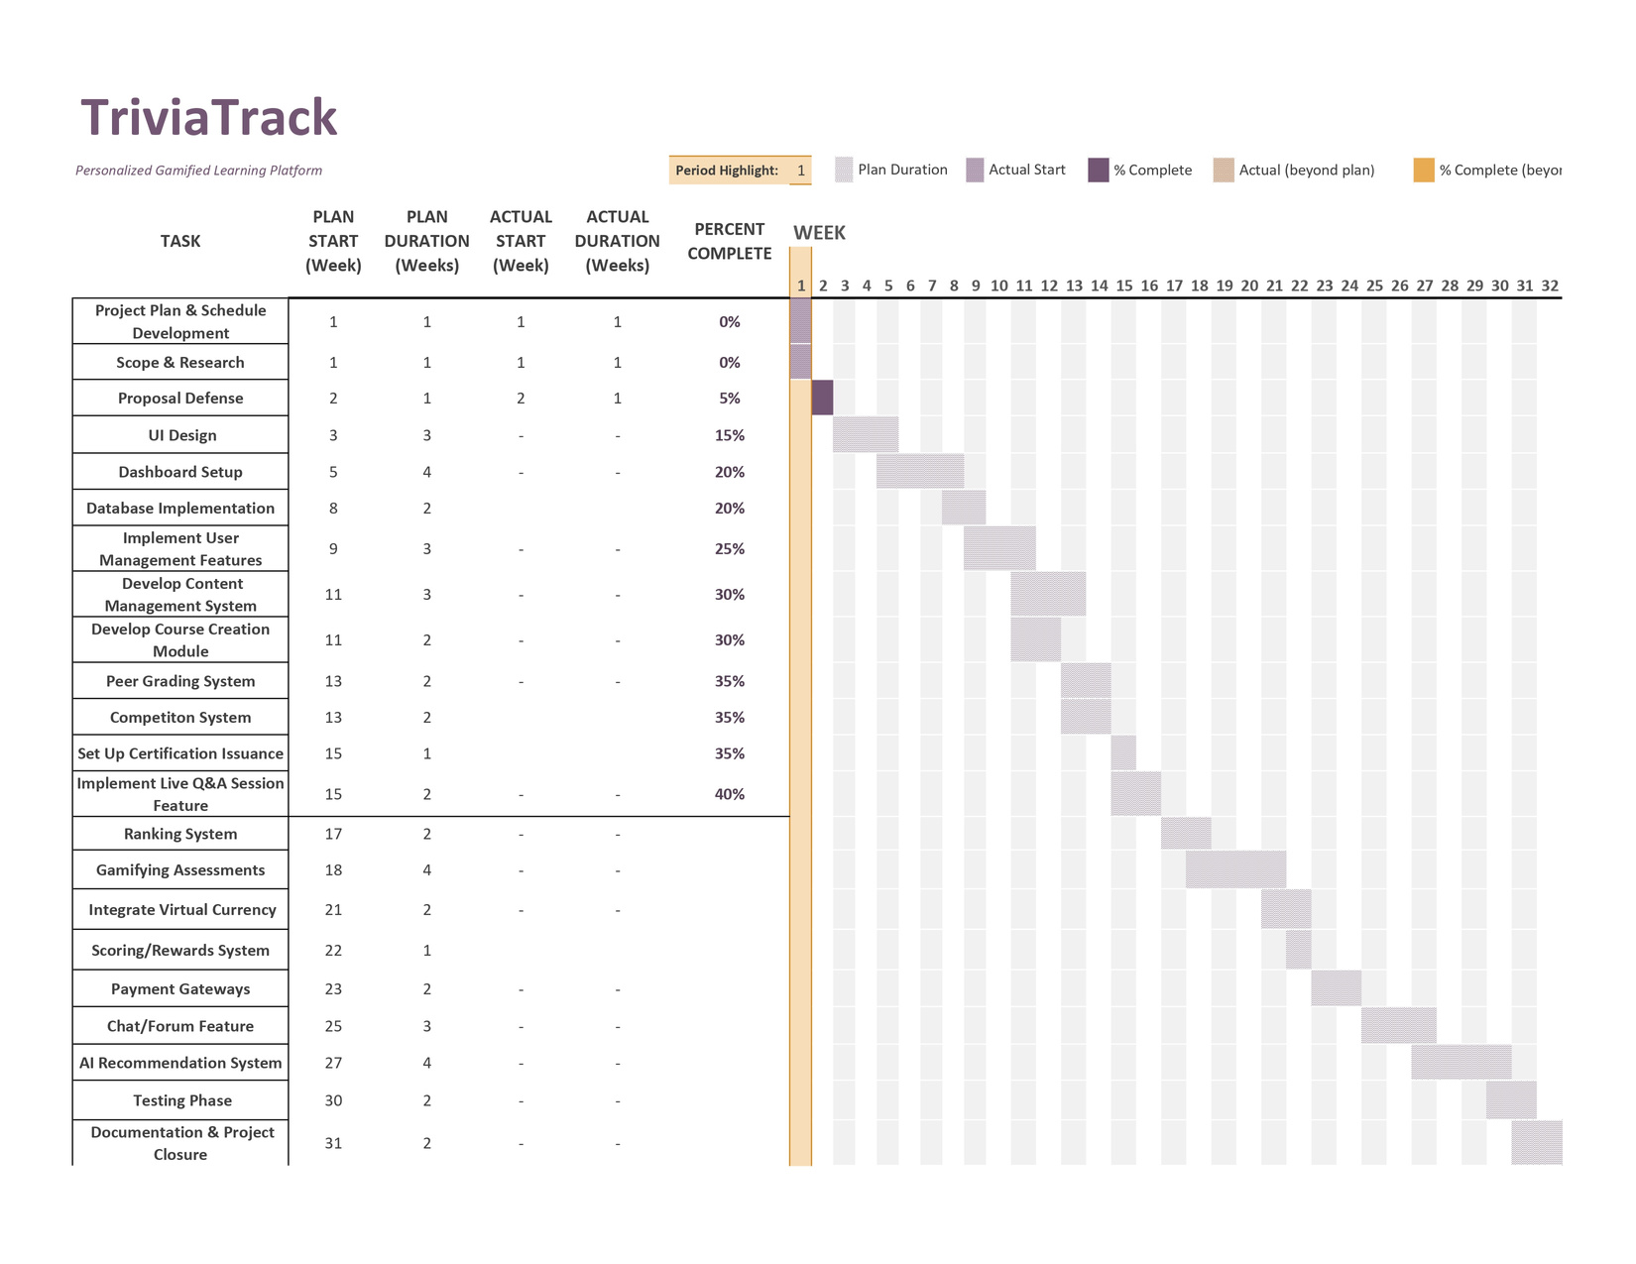
TRIVIATRACK
FYP II

Slide 14
TRIVIATRACK
THANK YOU

